Slide 1

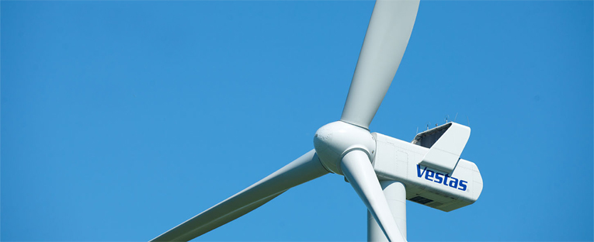
Rozwój energetyki wiatrowej
– doświadczenia Vestas
Ewa Zbierajewska
Tomasz Surma
6 listopada, 2012 r.

Slide 2
Plan prezentacji
O Vestas
2. Rynek energetyki wiatrowej – stan obecny i perspektywy rozwoju
3. Doświadczenia Vestas w rozwoju energetyki wiatrowej
4. Nowe turbiny oferowane na rynek
5. Proces sprzedaży elektrowni wiatrowych w Polsce – wyzwania rynku

Slide 3
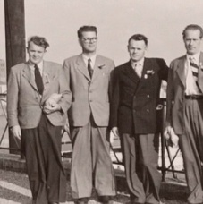
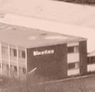
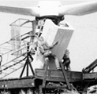
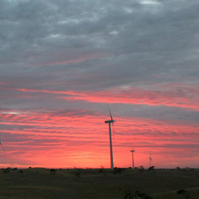

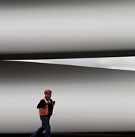
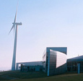
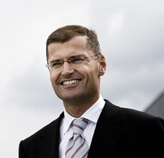
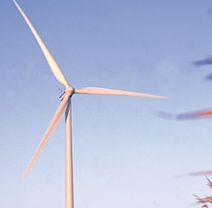
Vestas
1898:
Blacksmith H.S. Lem
1945:
VEstjysk STaalteknik A/S jako VESTAS – pojazdy rolnicze
1979:
Pierwsza turbina wiatrowa
1987:
Vestas
Wind Systems A/S
1991:
1,000 turbina wiatrowa
2004:
Połączenie: NEG Micon & Vestas
2005:
Ditlev Engel, CEO
2010:
Wind. It means the world to us.
Notes:
IT STARTED VERY SMALL WITH ONE MAN’S IDEAS
Selected events in Vestas’ history:
1898: The year it all begins
Blacksmith H. S. Hansen steps off the train at Lem Station in Denmark. A short time later he establishes his first smithy in the town, his wealth of ideas and initiative making him immediately successful. He later inspires many of his apprentices to open their own businesses, and Lem eventually becomes a major centre for the trade.
1928: Success for Dansk Staalvindue Industri
"Blacksmith Hansen" and his son Peder Hansen establish Dansk Staalvindue Industri, which manufactures steel window frames for industrial buildings. The company is a success and four years later is restructured into a joint stock company. The success continues until World War II, but during the German occupation of Denmark, metal is in short supply and staff can only be given intermittent work.
1945: Establishment of Vestas
Peder Hansen leaves Dansk Staalvindue Industri. Together with nine other people he establishes VEstjysk STaalteknik A/S, which is quickly abbreviated as simply Vestas. With initial capital of DKK 75,000, they set themselves up in a wooden barrack and begin manufacturing household appliances such as mixers and baking scales.
1950: The first venture into exporting
Production mainly consists of agricultural vehicles. First rubber tractors, then vacuum tankers, tankers, crop sprayers, ploughshares and other products, which become big export items, particularly in Finland, Germany and Belgium.
1956: Production of intercoolers
Soren Hansen, deputy director at B&W shipyards and Peder Hansen’s brother, tells his brother that the shipyard is interested in the development of a new type of cooler for marine engines. This marks the birth of yet another Vestas product. Peder Hansen takes on the task of developing and producing intercoolers - which together with the agricultural vehicles - are now Vestas' main products.
1959: “Blacksmith” Hansen buys out the others
Peder Hansen buys the other shareholders out of Vestas and sells the production of milk coolers and troughs to Boerge Agerbo, owner of Agerbo Maskinfabrik and one of Vestas' former shareholders.
….
1978: Experimenting with the whisk
The second oil crisis is looming and Vestas begins to look into the potential of wind turbines as an alternative and clean source of energy. The Darrieus wind turbine, which looks like a whisk standing upright, is the first experiment. It does not live up to expectations, and after one and a half years of experimenting, Vestas switches to a three blade model – in principle the same type of turbine we know today.
1979: The first turbine
Vestas delivers the first wind turbines to customers who want to invest in sustainable energy. In the years that follow, it is clear that Vestas did the right thing by beginning the production of wind turbines, because the industry sees a real boom in the early 1980s. Six years later Vestas has about 800 staff. It is during this period that Vestas builds its first large turbine factory, measuring 12,000 m2, on the outskirts of Lem, Denmark.
1980: Serial production of wind turbines
Vestas begins serial production of wind turbines and installs the first 80 units of 55 kW turbines. That same year Zond, Inc., an American company, asks to test Vestas’ turbines. These tests go well, and Zond is very happy with the turbines’ performance. New legislation in Denmark and the USA creates a large market for wind energy.
1981: Own production of glass fibre components
The first large orders from the USA come in and Vestas decides to produce its own glass fibre components for the wind turbines to ensure consistent, high quality components.
1983: 2,500 wind turbines sold to the USA
Glass fibre production is double that of 1981, enabling Vestas to manufacture its own blades for its wind turbines. Vestas North America, Ltd. is set up to service the American market. By the end of 1985 Vestas has sold 2,500 wind turbines to the USA.
1985: The first pitch
The first pitch-regulated turbine rolls out of Vestas’ factory. This feature, which optimises the turbine’s energy production by constantly fine-tuning the angle of the blades to the wind, becomes a key selling point. In fact, none of the competitors can offer anything like it. Since then, Vestas' pitch-regulation has become known by the name OptiTip®.
1986: Problems and rescue plan
A difficult year for Vestas. The special tax laws that made it advantageous to build wind turbines in California lapsed in late 1985 and early 1986. A rescue plan is put into action in February, but on 3 October the Group goes into suspension of payments.
But there is nothing wrong with the wind turbines, and Vestas’ quality products and in-depth know-how quickly prove to be a solid foundation for a restructuring. During 1986 Vestas has its first experiences with wind farms – an important factor in the successful fight to gain market share in the coming years.
1987: Disposal and establishment of Vestas Wind Systems A/S
Large portions of the Vestas Group are sold after the crisis in 1986. At the end of 1986 Vestas Wind Systems A/S, working solely with wind energy, is founded. With Johannes Poulsen as the new Managing Director and about 60 employees, the second chapter of Vestas' history begins. The same year Vestas RRB India Ltd. is founded in India.
1988: Danida projects in India
Vestas Wind Systems A/S is selected for six wind energy projects in India sponsored by Danida, a Danish state-financed aid agency.
1989: From collaboration to sales company
Strong political forces want to strengthen the Danish wind turbine industry through mergers. Vestas chooses to collaborate with Danish Wind Technology (DWT), which subsequently operates as a sales company within Vestas Wind Systems A/S. The purchase bolsters Vestas' production capacity and expertise. Vestas Deutschland GmbH is founded in Germany.
1990: Weight reduction and giant orders
In addition to increasing sales figures, Vestas distinguishes itself with a formidable technical achievement significant to the appearance, performance and price of the turbines – Vestas successfully manufactures a blade for the new V39-500 kW turbine where the weight is reduced from 3,800 kg to 1,100 kg.
1990 sees the largest order placed with Vestas for wind turbines to date. 342 V27-225 kW turbines are erected at Sky River northeast of Los Angeles, California.
1991: Breakthrough year and turbine number 1,000
Vestas' breakthrough year, where sales increase by 35 per cent to DKK 631 million. In November, Vestas 1,000th turbine is erected in Denmark. Vestas Wind Systems A/S becomes the first wind turbine manufacturer to receive ISO 9002 certification. Certification ensures that all production procedures follow a preset plan and that the final product is of a uniform and high quality.
1992: Rule Britannia
In 1992 the UK market shows the greatest expansion of all Vestas markets. A total of 89 Vestas wind turbines with a total capacity of 30 MW are installed in England, of these 23 WD 34-400 kW turbines on Ovenden Moor.
Vestas Wind Systems A/S expands with subsidiaries Vestasvind Svenska AB in Sweden and Vestas – American Wind Technology, Inc. in the USA.
1993: Political support triples sales
Political support for wind energy in Germany helps Vestas Deutschland GmbH triple its sales. The facilities in Husum are expanded by 750 m2. In Denmark too, the growth means expansion in administration as well as production. Large turbines and large wind turbine parks make it important for Vestas to supply turnkey projects.
1994: Growth and Spanish joint venture
At the end of 1994, Vestas Wind Systems A/S employs 765 people. The growth continues and 1994 becomes yet another record year with a pre-tax profit of DKK 41 million. But Vestas can also feel the increasing competition from other wind turbine manufacturers and notes a slight drop in its market share both in Germany and in the USA.
The development of the V44-600 kW turbine is completed. There are two new exciting features on the turbine: OptiTip®, which minimises the stress on the turbine blades, and OptiSlip® which provides an even electrical output to the network.
As part of an extensive consolidation, Vestas takes over Voelund Staalteknik A/S in Varde, Denmark.
In Spain, Vestas Wind Systems A/S, in collaboration with the Spanish group Gamesa and development company SODENA, establishes a joint venture company – Gamesa Eolica S.A., with Vestas Wind Systems A/S holding a 40 per cent share. The merger results in an immediate order of six V39-500 kW turbines from electrical company Energia Hidroelectrica de Navarra S.A.
1995: Restructuring and Tunoe Knob
A year with major restructurings within Vestas. In Videbæk, between Herning and Ringkøbing, in Denmark, 15,000 m2 of production and administration facilities are leased to be used as a purchasing, warehouse, assembly, distribution and service centre.
In Spain, where Gamesa Eolica S.A. has great successes selling Vestas technology, the local production of towers is established. On the technology front, Vestas erects a 1.5 MW turbine at Tjæreborg. As a new feature, this wind turbine has individual pitch regulation on all three blades, increasing both safety and durability when the blades run at maximum speed.
The really big event – and challenge – for Vestas in 1995 is the construction of the offshore wind turbine farm Tunoe Knob in the Kattegat, southeast of Århus, Denmark. The project is completed in collaboration with I/S Midtkraft which handles the foundations, while Vestas handles the assembly of the wind turbines. After the foundations are laid, Vestas takes over the project and in just five days the 10 units of V39-500 kW wind turbines are in place.
The wind turbine industry receives support from an unexpected source when the International Atomic Energy Agency determines that wind power, all things considered, will be fully competitive with both fossil fuels and nuclear energy no later than 2010.
1996: Medal of Honour to Vestas and Spanish fairy tale
Vestas is awarded the King Frederik IX's Medal of Honour for meritable achievements in Danish export.
China and India are promising new markets with 56 and 63 units of V42-600 kW turbines sold respectively, and Vestas Deutschland GmbH manages to increase Vestas' market share in an otherwise declining market. Spain, the country to show the best results, however. actually does so well it is called “the Spanish fairy tale”. Gamesa Eolica S.A. delivers 130 units of V39-500 kW turbines, and an agreement is reached with Energia Hidroelectrica de Navarra S.A. for delivery of 107 MW before December 2000 – an agreement that Gamesa Eolica S.A. expects to deliver before April 1997.
1997: Largest Danish wind turbine project
With increases in MW sales of 24 per cent - from 303 MW in 1996 to 383 MW in 1997 – there is good reason for optimism at Vestas. Vestas introduces two new types of turbines: The V47-660 kW and the V66-1.65 MW.
The largest wind turbine project to date on Danish soil is completed at Klim Fjordholme in Thy when Vestas, in collaboration with A/S Nordjyllandsværket, erects 35 units of V44-600 kW turbines. The wind farm is to supply electricity to 10,000 households.
1998: Stock exchange listing and success in Italy
Vestas goes public and its shares start trading on the Copenhagen Stock Exchange. The purpose is to acquire capital for continuing growth in all markets, which, for example, requires new facilities for glass fibre production and assembly. With a share of 22.1 per cent of the world’s wind power (measured in installed MW as of 13 December 1998) Vestas is the industry’s dominant player. Sales increase by 45 per cent and pass DKK 2.8 billion.
After two years of preparation, Vestas Wind Systems A/S establishes a joint venture in Taranto, Italy in partnership with Wind Energy System Taranto S.p.a. The company ends the year with sales amounting to DKK 258 million, despite the fact that the company is in a startup and training phase.
1999: New blade factory and sales increase of 131 per cent
The important markets grow and blade production capacity is soon insufficient. Vestas therefore decides in February to build a new blade factory in Nakskov, Denmark, where the access is good for land and sea transport and skilled labour is available. Building begins in the summer and the first 32-metre blades are manufactured in the new facility on schedule in December.
In the autumn Vestas introduces a V80-2.0 MW with Optispeed® that has been specially developed for areas with low wind speeds.
Vestas takes over the electronics company Cotas Computer Technology A/S in Århus, Denmark. Cotas has been the main supplier of software and components for turbine controls at Vestas for many years.
The year ends as well as possible for Vestas with sales totalling DKK 4.7 billion. The surplus amounts to DKK 597 million – an increase of 131 per cent compared to the previous year. On 20 December Vestas is listed on the prestigious Copenhagen Stock Exchange Index (KFX) that comprises the 20 most highly traded stocks in Denmark by volume. The demand for wind technology continues, and Vestas is the stock that shows the greatest price increase for the year.
2000: The largest order to date and a new sales record
The new millennium barely starts before the largest order to date of 1,800 turbines is received by Gamesa Eólica S.A., of which Vestas owns 40 per cent. The client is the Spanish energy company Energía Hidroeléctrica De Navarra, S.A. The total value is in excess of DKK 5 billion.
In May the new 22,000 m2 factory in Nakskov, Denmark, is completed.
Vestas strengthens its position in the Japanese market by signing a new distribution agreement with Vestech Japan Corporation. The agreement is followed up in the autumn with a new order for Japan for 24 turbines of the type V66-1.65 MW for delivery in 2001.
The American market shows very positive signs as a result of the extension of the Production Tax Credit. Vestas signs the largest agreement to date in the USA for sales of V47-660 kW turbines to FPL Energy, LLC for delivery in 2000 and 2001. For the U.S. market, the development of a new OptiSlip® version V80 turbine is underway. This new wind turbine is expected to be in serial production in early 2002.
In August, Vestas receives ISO 14001 certification that documents that Vestas has implemented a new environmental management system. The certification includes Vestas' activities for the external environment. Vestas continues to work towards British standard OHSAS 18001 certification for the work environment.
In November, Vestas offers shares to all employees for the second time. More than 80 per cent of eligible employees choose to take up the offer. Similarly, warrants were issued for the first time to the company’s board of directors, executive committee and senior management.
The global market for wind power grows by approximately 4,500 MW of newly installed capacity. Vestas' share, including associated companies, amounts to 1,434 MW corresponding to a market share of 32 per cent. This means that Vestas has supplied approximately 26 per cent of the installed capacity throughout the world, and has therefore reached its goal of 25 per cent, an historical market share.
Vestas reaches sales of DKK 6.5 billion and pre-tax profit of DKK 866 million, which is a new record. With Earnings Before Interest and Taxes (EBIT) amounting to 10.7 per cent, a financial goal of 9 per cent is reached too.
At the end of the year the Group has 3,852 employees – an increase of 47 per cent. In addition to this, there are 1,131 employees in associated companies in Spain and India.
2001: Horns Rev – the world’s largest offshore wind farm
In January, Vestas is selected to be the wind turbine supplier for the first large offshore project in the North Sea, the Horns Rev project west of Esbjerg in Denmark. The project, to be constructed during the summer of 2002, is one of the world’s largest offshore wind farms to date with a capacity of 160 MW. The turbine type chosen is the Vestas V80-2.0 MW and the anticipated order value is projected to be about DKK 1 billion.
In the spring, Vestas also signs its first contracts in Costa Rica and Iran. A number of new markets are also showing positive signs, including France, Portugal and Poland.
The first half of 2001 is characterised by a flurry of activity clearly reflected in the interim financial results. Net turnover for the first half of 2001 doubles compared to 2000 and amounts to DKK 4,544 million. Pre-tax results for the first six months increase by 35 per cent to DKK 401 million.
An important subgoal for the working environment is reached in August 2001 when Vestas is awarded British OHSAS 18001 certification documenting that the working environment management system in the Group’s Danish factories conforms to the standard.
In September Johannes Poulsen announces to the Board that on his 60th birthday and after 15 years as Managing Director of Vestas Wind Systems A/S he wishes to retire at the general meeting on 18 April 2002. The Board appoints Svend Sigaard, the current chief financial officer, as the new managing director of the company effective from the same date.
In December, Vestas Wind Systems A/S sells its 40 per cent holding in Gamesa Eólica S.A. to Sesa Sistemas Electricos S.A., part of the Gamesa Group, for EUR 287 million (ca. DKK 2.1 billion). The reasons behind the sale include strategic differences between Vestas and Gamesa in relation to project development leading to an increasing number of strategic conflicts in the market.
The global market for wind power grows by approximately 51 per cent to 6,824 MW, of which the Vestas Group, including associated companies, has 1,645 MW in sales – double compared to the year before. Vestas achieves a market share of 24.1 per cent and thus an increase of six percentage points compared to 2000.
Sales amount to DKK 9.52 billion with a surplus before EBIT amounting to DKK 985 million. Pre-tax results amount to DKK 2.85 billion which includes DKK 1.81 billion for the sale of shares in Gamesa Eólica S.A.
At the end of the year Vestas employs 5,240 people, of which 825 work in foreign subsidiaries.
2002: Another record year
A challenging year for Vestas in many ways. Despite a number of problems, it becomes yet another record year for the wind turbine industry and Vestas. The total installations of wind power in the world will amount to approximately 7,000 MW, equal to an increase of approximately three per cent. Vestas sales increase by nine per cent from EUR 1,282 million to EUR 1,395 million.
The American market does not develop as expected in early 2002. Consequently, capacity is reduced in the U.S. and about 1,200 skilled and qualified staff have to switch to part-time work for three months.
On 18 April Johannes Poulsen, the Managing Director for 15 years, retires and Svend Sigaard, Chief Financial Officer, takes over his position as the Managing Director of Vestas.
In April, Vestas starts installation of 80 units of 2.0 MW offshore wind turbines at Horns Reef in the North Sea off the Danish west coast – the largest contract undertaking in 2002. Many employees make a great effort to ensure that the offshore wind farm gets established according to plan. The good teamwork within the whole Vestas group means that Vestas can erect the 80th and final turbine 11 days earlier than originally planned. At the end of 2002, the establishment of the world’s largest offshore wind farm to date is a reality, and in the future the park will supply electricity to approximately 150,000 Danish households.
The valuable experience gained from the Horns Reef project contributes to Vestas being selected as the supplier of wind turbines for several offshore wind farm projects in Europe in 2002. In July, Vestas receives an order for 30 units of V80-2.0 MW offshore wind turbines, which will be the first large offshore wind farm in England. Later in the year, Vestas is selected to be the supplier of offshore wind farms in England and Belgium.
With the establishment of the Horns Reef offshore wind farm and subsequent orders, Vestas seals its position as the world’s leading producer of offshore wind turbines.
As in previous years, Vestas ends 2002 with the establishment of new production facilities. A 10,000 m2 factory is opened in the Campbeltown, Scotland. The factory manufactures towers and assembles nacelles. Vestas is thus well prepared to service the growing UK and Irish markets. A 31,500 m2 factory producing blades is opened in Lauchhammer, Germany.
Vestas erects the first V90-3.0 MW prototype turbines – the next generation in Vestas' product program. These prototypes have to pass a trial period before serial production begins in 2004.
Due to continuing uncertainty on the American market, the expectations for growth in 2003 are lowered, and Vestas unfortunately is obliged to make 495 employees redundant at the end 2002. Despite this, there is a net staff gain of 759 in 2002.
With good market spread, a strong product range, a good order volume both onshore and offshore, as well as highly qualified, motivated staff, Vestas is well prepared for the future. Vestas expects that wind power will become one of the world’s leading energy sources.
2004: Vestas and NEG Micon merge. The two wind energy giants become the undisputes world leader in the wind power industry.
2005: Ditlev Engel new CEO of Vestas.
2010: Wind. It means the world to us. (elaborated on slide 14)

Slide 4
Vestas
Producent urządzeń energetyki wiatrowej
50 GW mocy zainstalowanej na świecie
30 000 turbin monitorowane 24/7
Prace badawczo rozwojowe nad nowymi produktami
  V112-3.0 MW onshore
  V126-3.0 MW onshore
  V164-8.0 MW offshore
  80 metrowe łopaty wirnika prototyp V164-8.0 MW
Notes:
These efforts, resulting in rising output, growing revenue and the best human resources in the market manifests itself physically around the globe:
Vestas installed base is twice as big as the second biggest player in the industry (GE).
A total of 46,143 Vestas wind turbines has delivered 49,332 MW as of 31 December 2011.

Slide 5
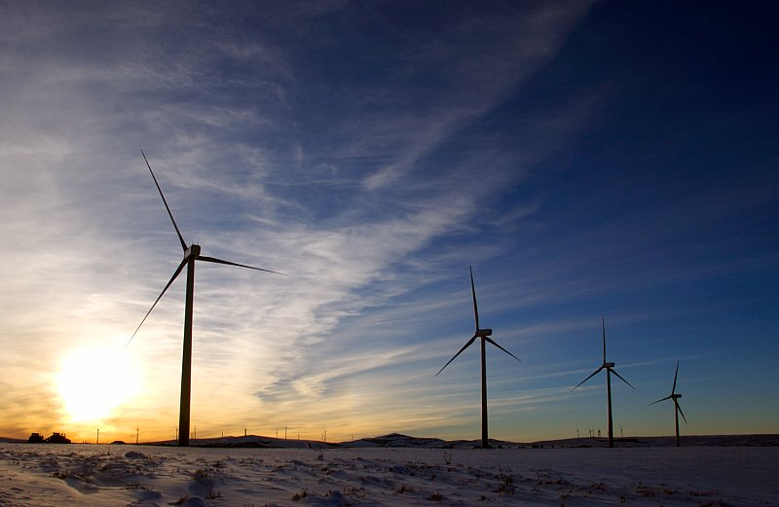
Vestas Poland
Vestas Poland rozpoczęcie działalności w 2003 r.
Vestas Poland w grupie Vestas Northern Europe
Pierwszy serwis elektrowni wiatrowych w Polsce
ok.140 pracowników
Biuro w Szczecinie, biuro w Warszawie (2012)
ok. 800 MW

Slide 6
Vestas Poland
Wind market leader
Rynek producentów turbin wiatrowych w Polsce

Slide 7
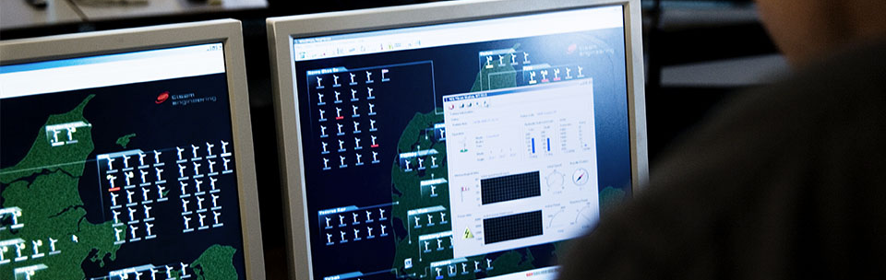
Product Portfolio
VestasOnline® Business
Vestas prowadzi szczegółowe ekspertyzy na potrzeby rozwoju projektów, oferując między innymi:
VestasOnline® Business
SiteHunt®
SiteDesign®
Electrical PreDesign®

Slide 8




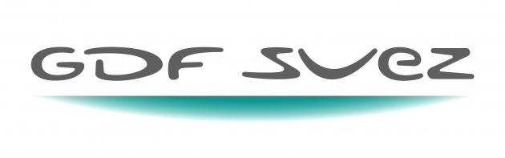



Vestas Poland
Some of our customers

Slide 9
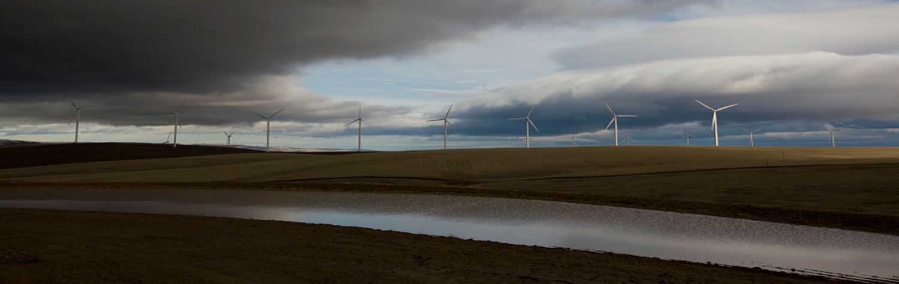
Rynek energetyki wiatrowej

Slide 10
Systemy wsparcia energetyki odnawialnej w UE
Feed-in
System kwotowy
LV
AT CY CZ DK EE
ES FR DE BG SK
SI GR HU IE FR
LT LU PT
BE IT
NL
SE RO
Świadectwa pochodzenia/zielone certyfikaty
PL UK
Bodziec cenowy
Bodziec ilościowy
UK
FI MT
FR IR
Podatki
Przetargi

Slide 11
Nowe moce w UE, MW
OZE
w. brunatny
e. maremotor.
e. geoterm.
olej
e. helioterm.
e. wodne duże
e. jądrowe
e. wodne małe
PV
węgiel
odpady
e. wiatrowe
gaz
biomasa
Źródło: EWEA

Slide 12
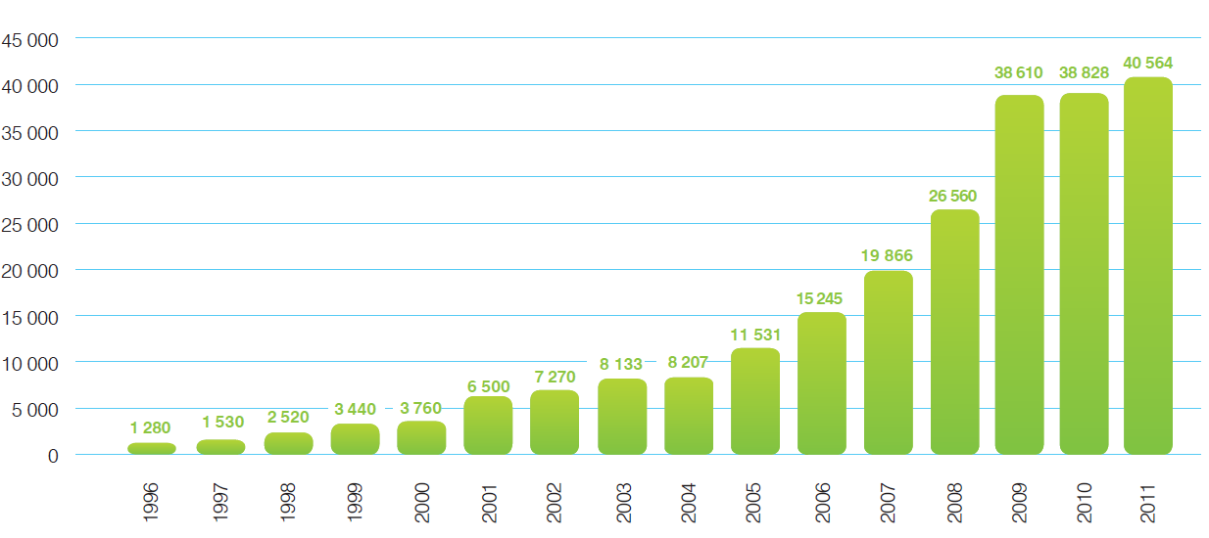
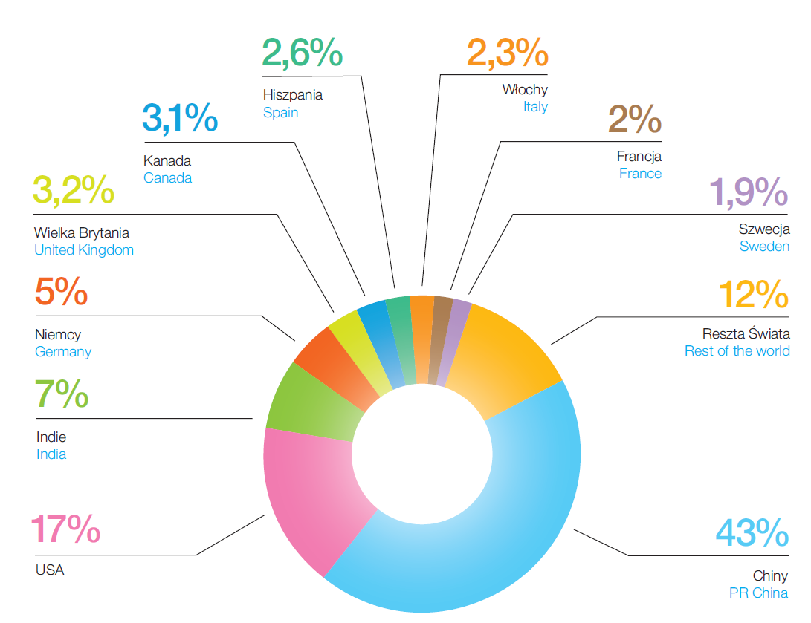
Przyrost mocy zainstalowanej energetyki wiatrowej na świecie
Źródło: GWEC

Slide 13
Udział energii elektrycznej z EW w zużyciu końcowym

Slide 14
Elektrownie wiatrowe na obszarach morskich

Slide 15
Doświadczenia Vestas w rozwoju energetyki wiatrowej

Slide 16
Charakterystyka wytwarzania w turbozespołach wiatrowych
Produkcja energii w turbinach wiatrowych zależy głównie od prędkości wiatru (υ) na terenie, na którym jest zlokalizowana elektrownia wiatrowa.
Krzywa mocy wytwarzanej w turbozespole wiatrowym:
υ_{r} – prędkość „rozruchowa” (startu, włączenia) turbozespołu, υ_{o} – prędkość „odcięcia” (wyłączenia) turbozespołu
Przykładowe krzywe mocy zidentyfikowanych typów turbozespołów wiatrowych

Slide 17
Charakterystyki probabilistyczne wiatru
Roczna zmienność prędkości wiatru dla lokalizacji Wolin (zmierzone w 2011 r.)
Przykład rozkładu prędkości wiatru
oraz aproksymacja za pomocą rozkładu Weibulla

Slide 18
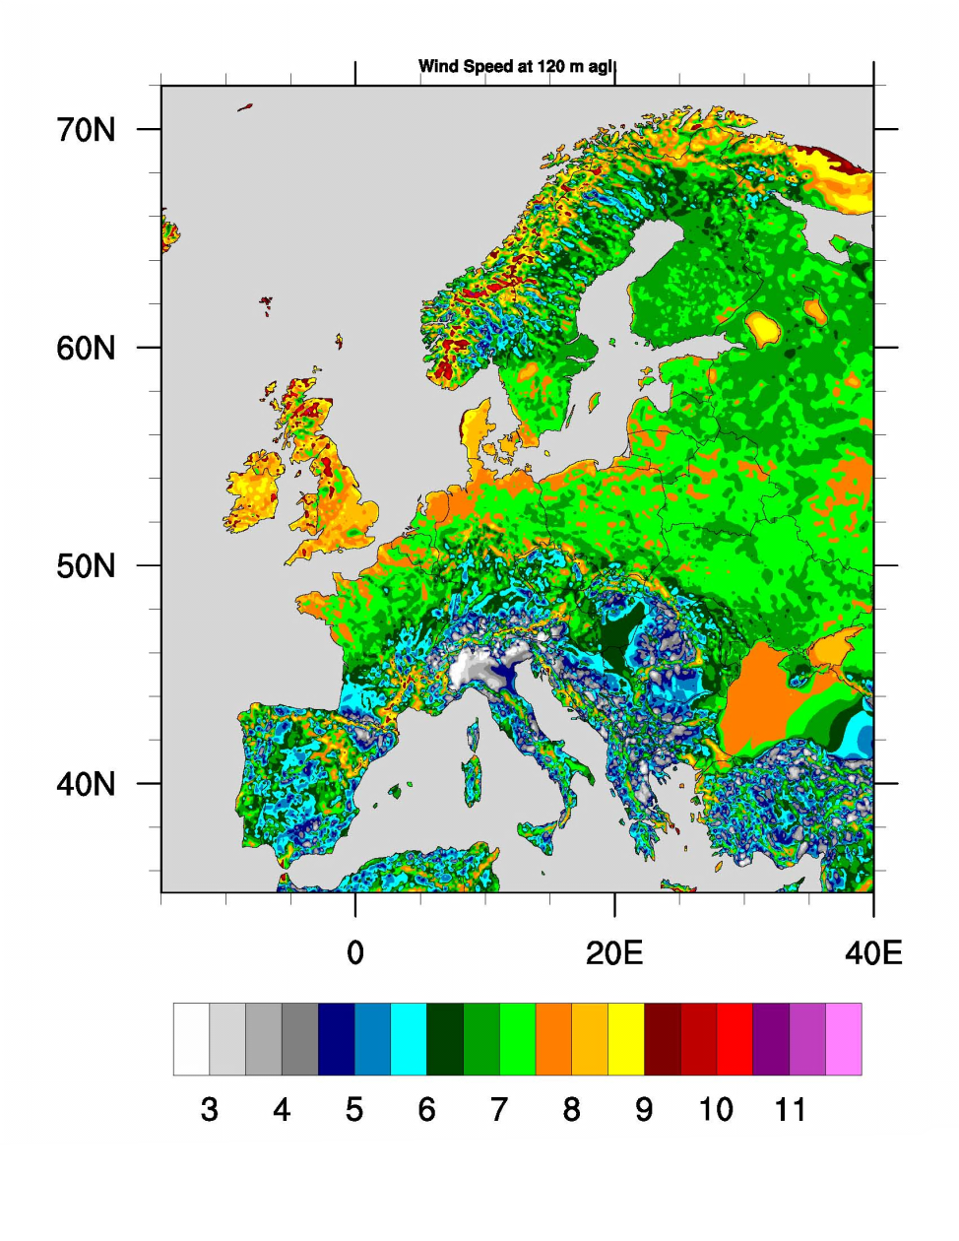
Potencjał rozwoju energetyki wiatrowej
V112- 3.0 MW i V126-3.0 MW™
Obszary na których występują, średnie i niskie prędkości wiatru stanowią więcej niż 2/3 powierzchni Europy*
*Source: Vestas W&S, Global Solutions and Services

Slide 19
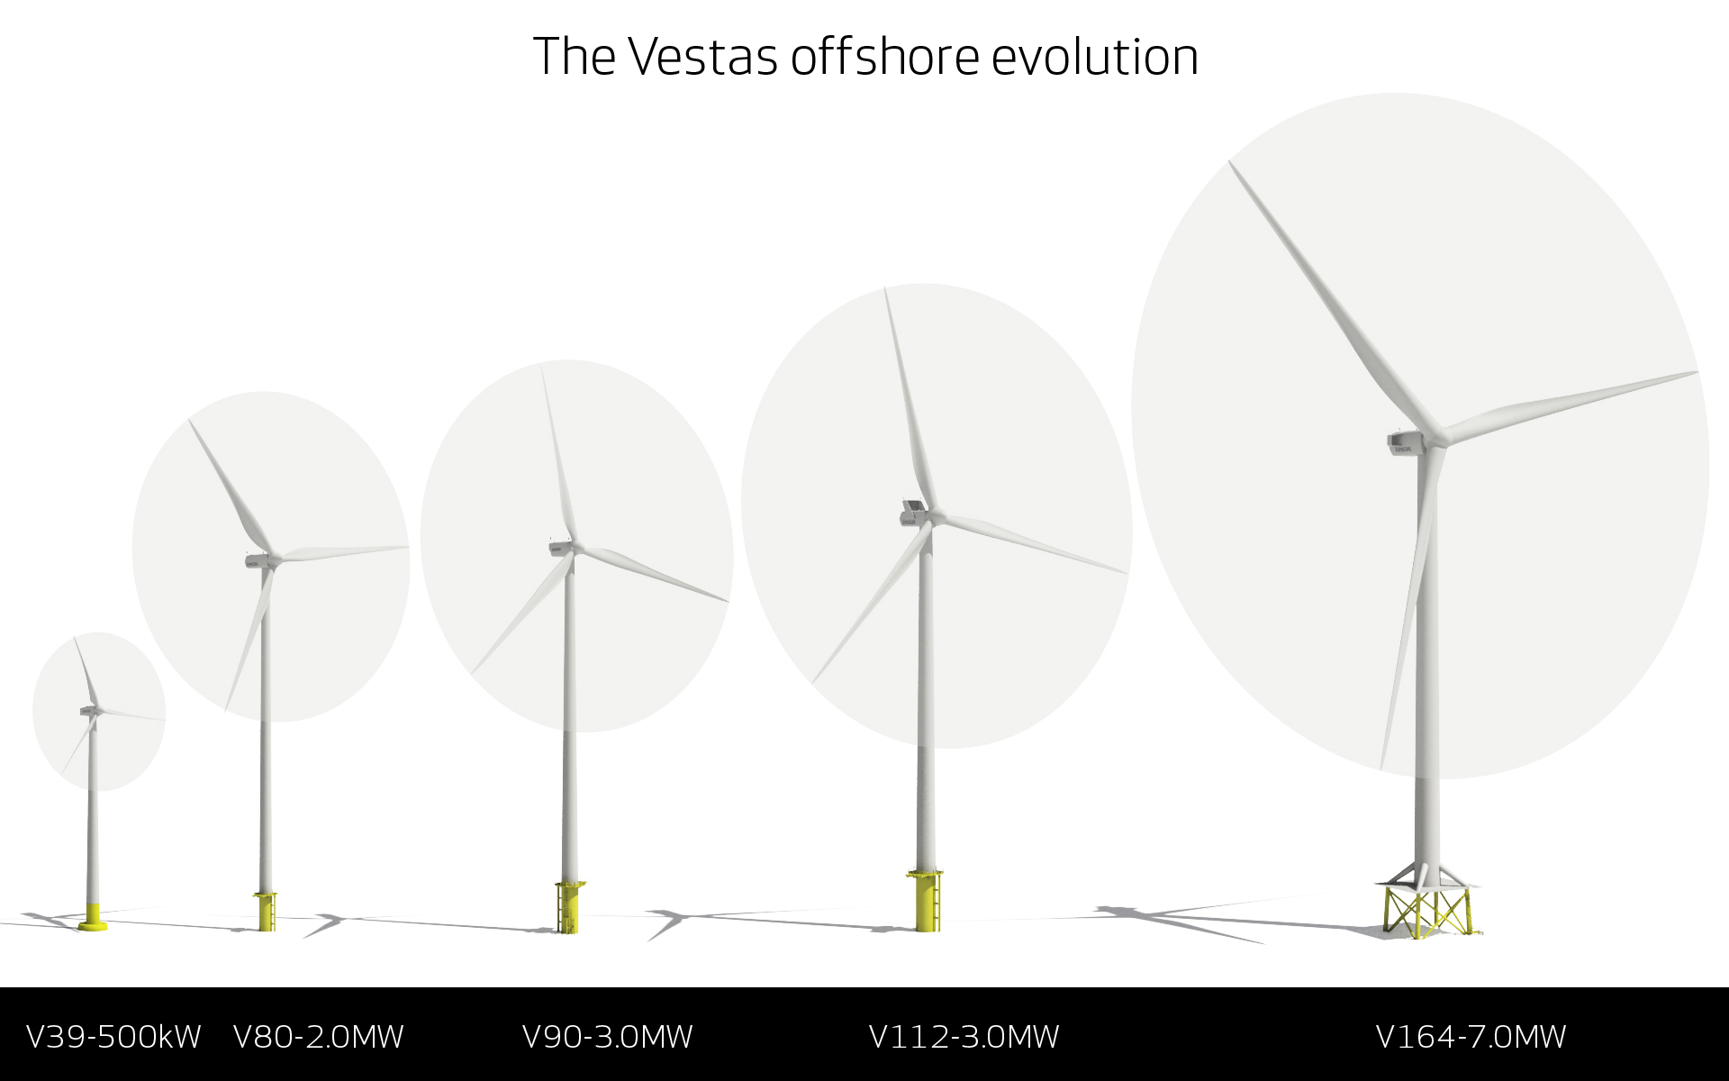
Vestas portfolio
Od turbin rzędu kW do jednostek MW
V39-500kW
V80-2.0MW
V90-3.0MW
V112-3.0MW
V164-8.0MW

Slide 20
Nowe turbiny Vestas

Slide 21
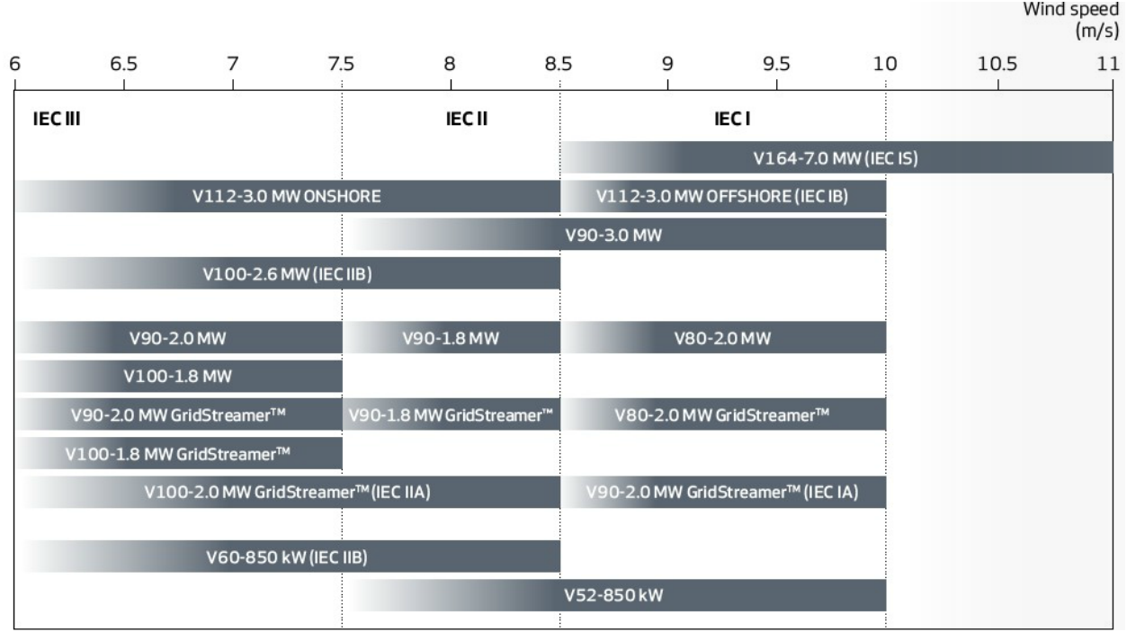
Przegląd turbin Vestas
Zastosowanie turbin Vestas w zależności klas wiatru

Slide 22
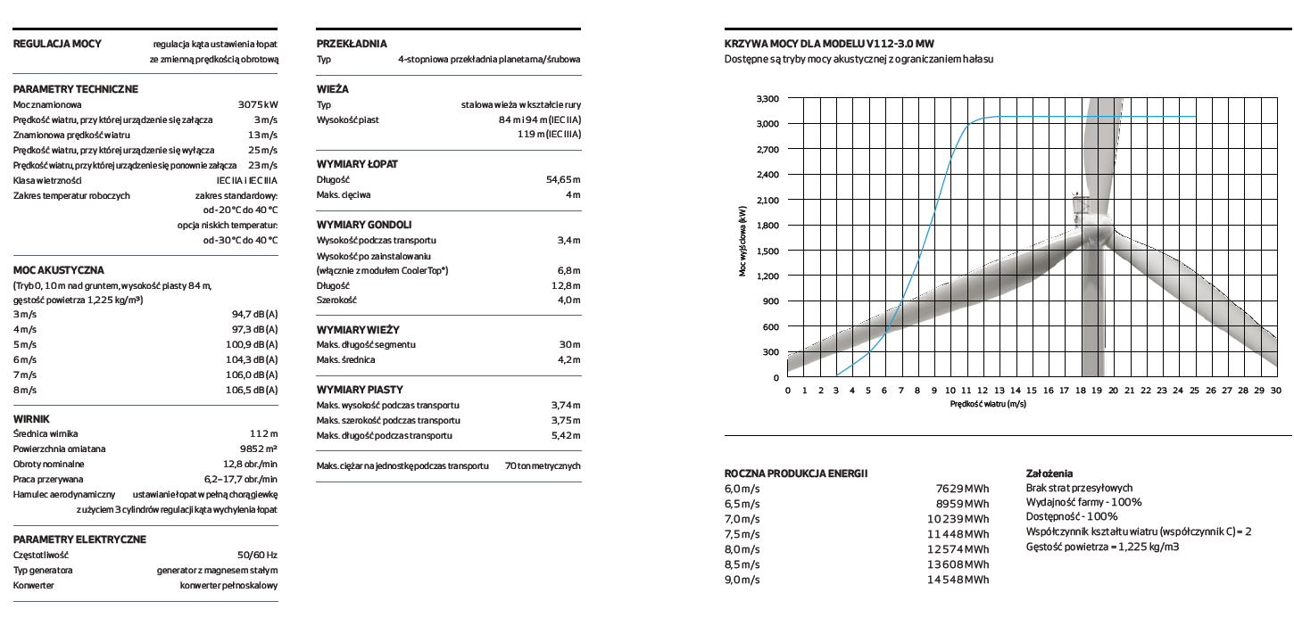
V112 3.0
Istotne dane turbiny

Slide 23
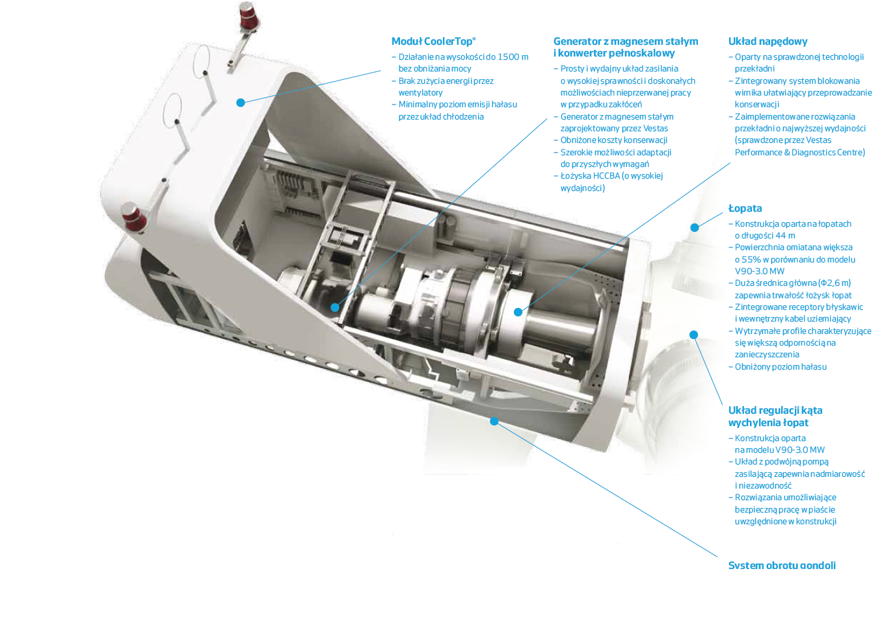
V112 3.0

Slide 24
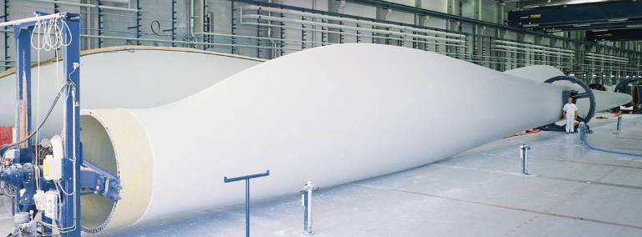
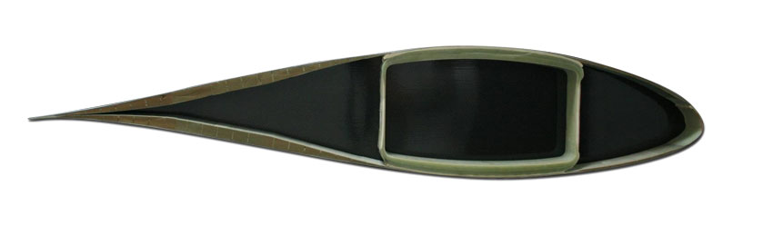
54.6 metrowe łopaty
Łopaty o długości 54,65 m umożliwiają wytworzenie większej ilości energii przy tej samej sile wiatru Cięciwa łopat to nadal 4m – brak dodatkowych ograniczeń transportowych Powierzchnia omiatania większa o 55% w porównaniu z modelem V90 – 3.0MW

Slide 25
Proces sprzedaży elektrowni wiatrowych – wybrane aspekty

Slide 26
Sprzedaż turbin
Przedsprzedażowe wsparcie klienta w zakresie projektowania
Dostawa i montaż turbiny
Serwis
  AOM 4000 Pakiet zawiera wszystkie niezbędne elementy (główne podzespoły i materiały). Umowa serwisowa obejmuje okres do 15 lat i bazuje na tradycyjnej gwarancji opartej na pomiarze czasu – do 97%.
  AOM 5000 Pakiet obejmujący wszystkie niezbędne elementy w celu zapewnienia maksymalnej wydajności wraz z dodatkowymi usługami. Umowa serwisowa obejmuje okres do 15 lat i oparta jest na gwarancji dostępności opartą na pomiarze energii na poziomie do 97% (w zależności od wyników analizy danej lokalizacji).
SCADA
  Turbiny Vestas korzystają z systemu nadzorującego gromadzenia danych SCADA (Supervisory Control and Data Acquisition). System VestasOnline ® Business umożliwia monitorowanie wydajności oraz tworzenie szczegółowych raportów z dowolnej lokalizacji na świecie.

Slide 27
Etapy projektu farmy wiatrowej
pozyskanie terenów pod elektrownię wiatrową
uzyskanie opinii Urzędu Lotnictwa Cywilnego i Wojskowego
raport z monitoringu chiropterologicznego i ornitologicznego
uzyskanie decyzji środowiskowej
zmiany w planach zagospodarowania przestrzennego gmin
wykonanie ekspertyz wpływu na KSE
wystąpienie o warunki przyłączenia farmy wiatrowej do sieci elektroenergetycznej
pomiary wietrzności
pomiary geologiczne
analizy archeologiczne
projekt elektryczny
projekt budowlany
pozwolenia na budowę

Slide 28
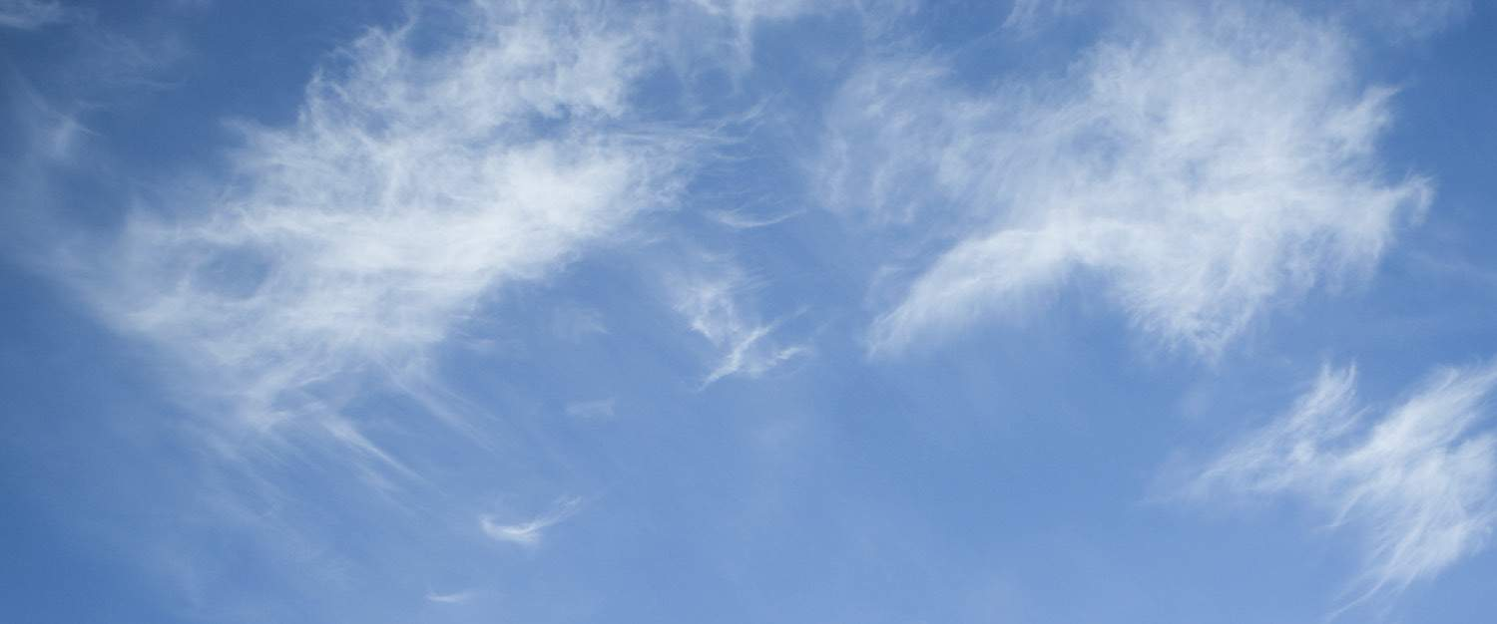
Ewa Zbierajewska ewzae@vestas.com
Tomasz Surma tasum@vestas.com
Copyright Notice
The documents are created by Vestas Wind Systems A/S and contain copyrighted material, trademarks, and other proprietary information. All rights reserved. No part of the documents may be reproduced or copied in any form or by any
means—such as graphic, electronic, or mechanical, including photocopying, taping, or information storage and retrieval systems without the prior written permission of Vestas Wind Systems A/S. The use of these documents by you, or
anyone else authorized by you, is prohibited unless specifically permitted by Vestas Wind Systems A/S. You may not alter or remove any trademark, copyright or other notice from the documents. The documents are provided “as is” and
Vestas Wind Systems A/S shall not have any responsibility or liability whatsoever for the results of use of the documents by you. Vestas wishes to acknowledge and respect all copyrights in connection with the illustrations used in this
presentation. In case we have unintentionally violated copyrighted material, we want to be informed immediately in order to straighten things out and thus to honour any obligatory fees.

